Slide 1

Lecture 4: Hyperelasticity and Parameter Calibration
(Pre-course: Constitutive Modelling of Soft Tissues)
Hao Gao
School of Mathematics and Statistics, University of Glasgow
Hao.gao@glasgow.ac.uk
https://github.com/HaoGao/SofTMechResources/tree/main/Training/ESB2024
Notes:
30 min Hao Gao: Hyperelasticity and Parameters: fibre-reinforced material, examples of typical SEFs, residual stress.

Slide 2
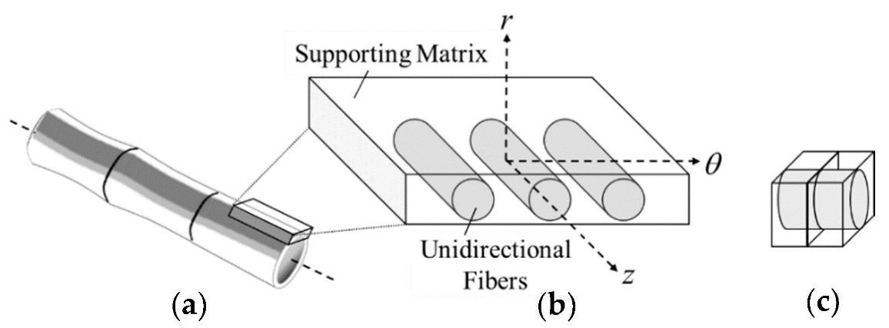
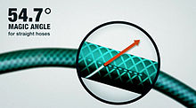
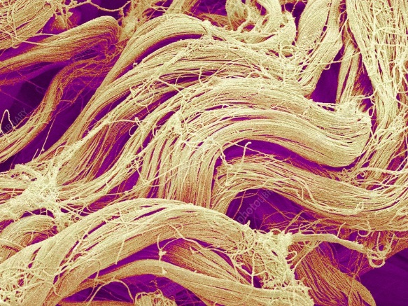
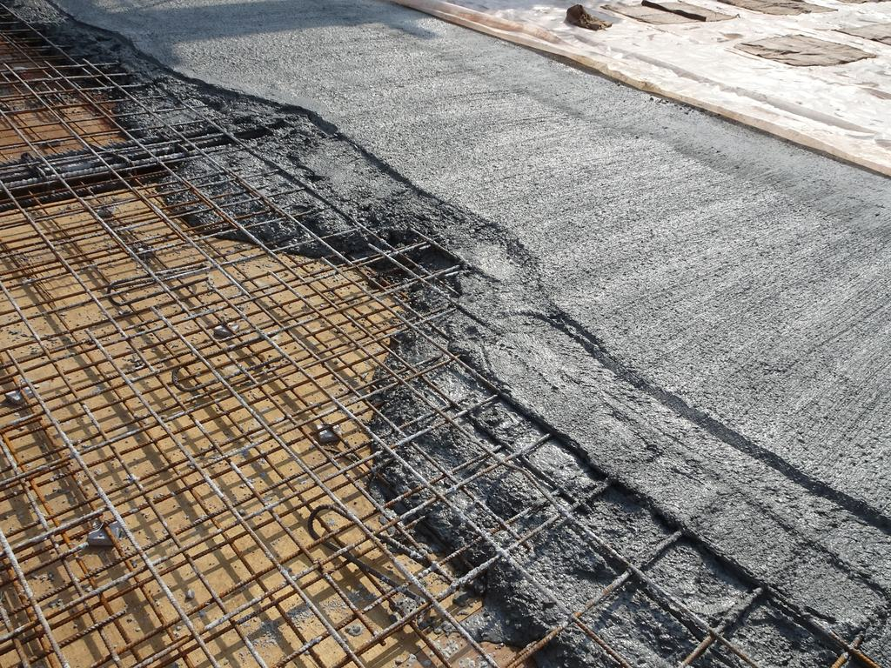
Some Examples of Anisotropic Material
Reinforced rubber
Bamboo/wood
Magic angle - Wikipedia
Concrete with steel mesh
Skins

Slide 3
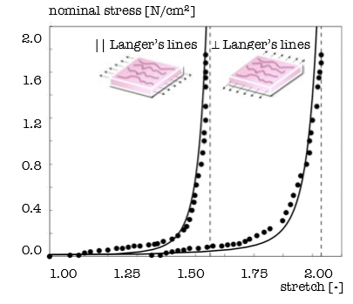
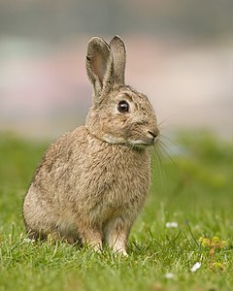
Skin Constitutive Modelling
Nonlinear
Anisotropic
Tong & Fung [1976]

Slide 4
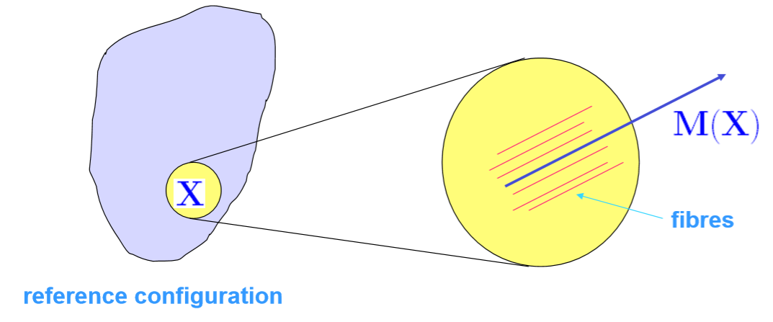
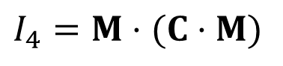
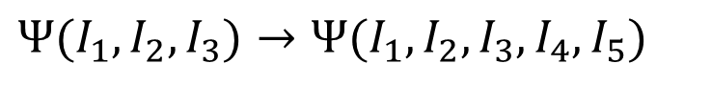
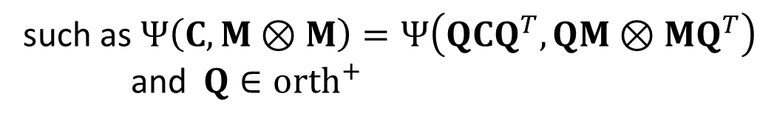
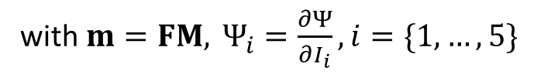
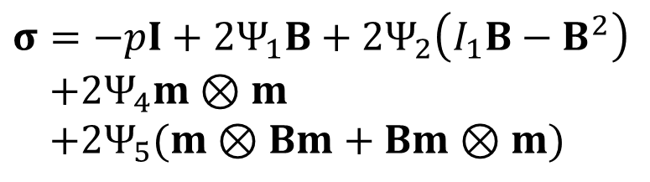

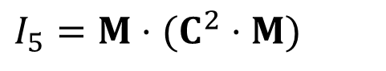
Modelling Fibre Reinforcement (one family)
Transversely isotropic
$$Ψ(I_{1},I_{2},I_{3})→Ψ(I_{1},I_{2},I_{3},I_{4},I_{5})$$
$$I_{4}=M⋅(C⋅M)$$
$$I_{5}=M⋅(C^{2}⋅M)$$
$$M \text{is} \text{the} \text{unit} \text{vector} \text{field}$$
The Cauchy stress tensor
$$Ψ \text{is} \text{a} \text{function} \text{of} C \text{and} M⊗M$$
$$σ=−pI+2Ψ_{1}B+2Ψ_{2}\left(I_{1}B−B^{2}\right)$$
$$+2Ψ_{4}m⊗m$$
$$+2Ψ_{5}(m⊗Bm+Bm⊗m)$$
such as $Ψ\left(C, M⊗M\right)=Ψ\left(QCQ^{T}, QM⊗MQ^{T}\right)$
and$Q∈orth^{+}$
with $m=FM,​ Ψ_{i}=\frac{∂Ψ}{∂I_{i}}, ​i=\{1,…,5\}$

Slide 5
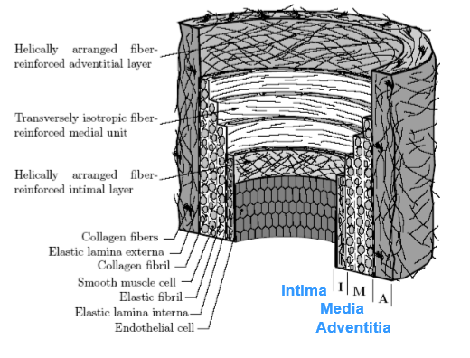
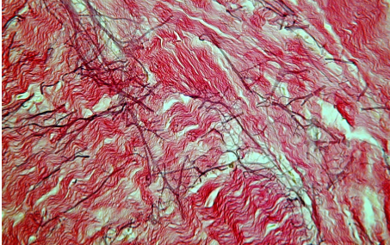
Layered Arterial Wall with Two Families of Fibres
(Holzapfel, et al 2000)

Slide 6
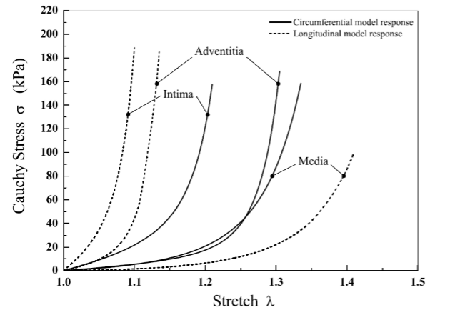
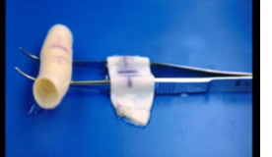
Example: Stiffness Comparison
Media
Adventia
Aged coronary
(Holzapfel, et al 2000)

Slide 7
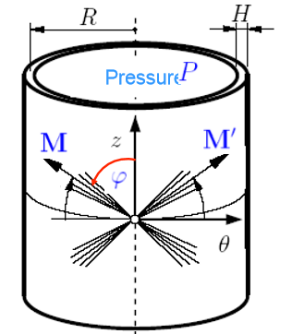
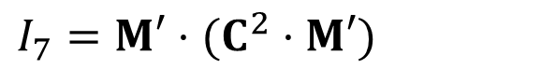
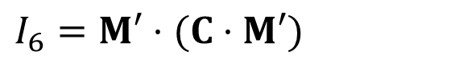
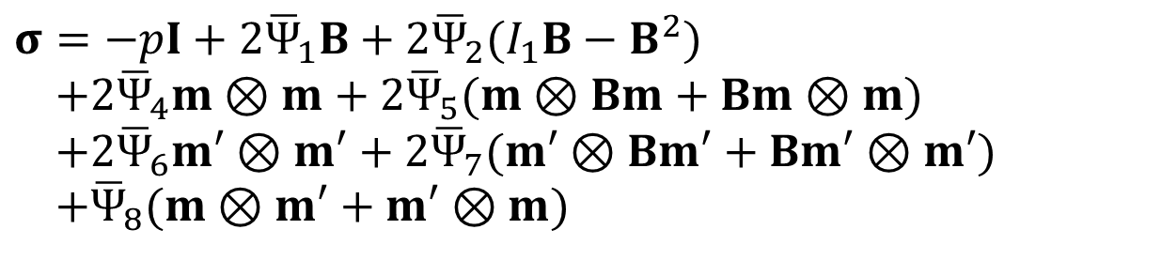
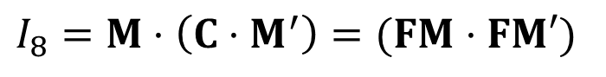
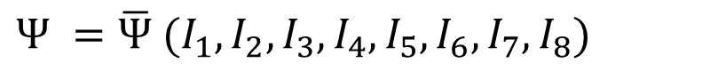
Invariants for Two Families of Fibres
In addition to $I_{1},I_{2},I_{3},I_{4},I_{5}$, we further introduce
$$I_{6}=M′⋅(C⋅M′)$$
$$I_{7}=M′⋅(C^{2}⋅M′)$$
$$I_{8}=M⋅\left(C⋅M^{′}\right)=(FM⋅FM′)$$
The strain energy function can be defined as
$$Ψ =\overline{Ψ} (I_{1},I_{2},I_{3},I_{4},I_{5},I_{6},I_{7},I_{8})$$
The Cauchy stress tensor
$$σ=−pI+2{\overline{Ψ}}_{1}B+2{\overline{Ψ}}_{2}(I_{1}B−B^{2}) \\ +2{\overline{Ψ}}_{4}m⊗m+2{\overline{Ψ}}_{5}(m⊗Bm+Bm⊗m) \\ +2{\overline{Ψ}}_{6}m′⊗m′+2{\overline{Ψ}}_{7}(m′⊗Bm′+Bm′⊗m′) \\ +{\overline{Ψ}}_{8}(m⊗m′+m′⊗m)$$
with $m=FM,​ m^{′}=FM^{′}, {\overline{Ψ}}_{i}=\frac{∂\overline{Ψ}}{∂I_{i}}, ​i=\{1,…,5\}$

Slide 8
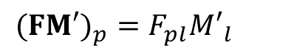
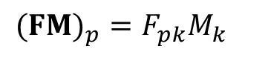
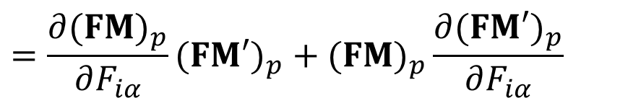
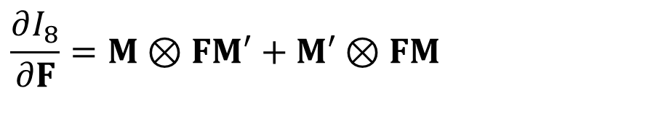
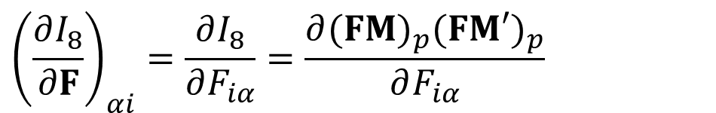
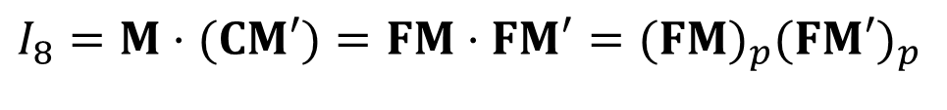
Pseudo-Invariant $I_{8}$
$$I_{8}=M⋅(CM′)=FM⋅FM′=(FM)_{p}(FM′)_{p}$$
$${\left(\frac{∂I_{8}}{∂F}\right)}_{αi}=\frac{∂I_{8}}{∂F_{iα}}=\frac{∂(FM)_{p}(FM′)_{p}}{∂F_{iα}}$$
$$(FM)_{p}=F_{pk}M_{k}$$
$$(FM′)_{p}=F_{pl}M′_{l}$$
$$=\frac{∂(FM)_{p}}{∂F_{iα}}(FM′)_{p}+(FM)_{p}\frac{∂(FM′)_{p}}{∂F_{iα}}$$
$$\frac{∂I_{8}}{∂F}=M⊗FM′+M′⊗FM$$

Slide 9
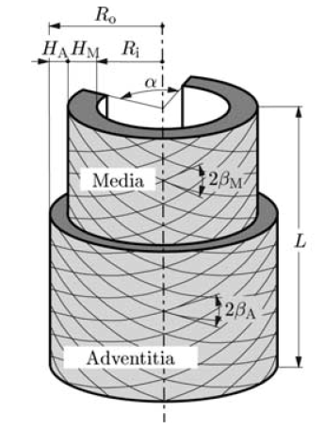
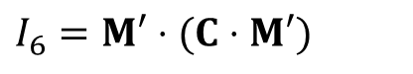
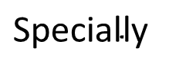
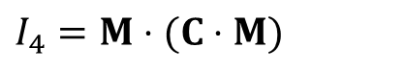
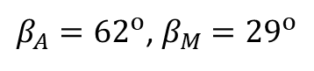
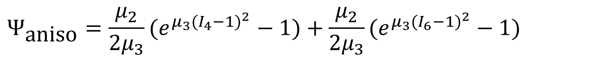
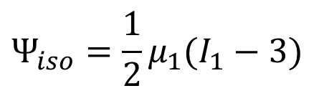
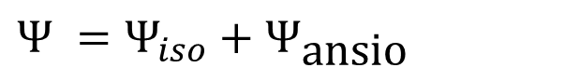
Example: The Holzapfel-Ogden-Gasser Model
$$\text{S}\text{pecially}$$
$$Ψ =Ψ_{iso}+Ψ_{\text{ansio}}$$
$$Ψ_{iso}=\frac{1}{2}μ_{1}(I_{1}−3)$$
$$Ψ_{\text{aniso}}=\frac{μ_{2}}{2μ_{3}}(e^{μ_{3}(I_{4}−1)^{2}}−1)+\frac{μ_{2}}{2μ_{3}}(e^{μ_{3}(I_{6}−1)^{2}}−1)$$
$$I_{4}=M⋅(C⋅M)$$
$$I_{6}=M′⋅(C⋅M′)$$
$$σ=−pI+μ_{1}B+2μ_{2}(I_{4}−1)e^{μ_{3}(I_{4}−1)^{2}}m⊗m$$
$$+2μ_{2}(I_{6}−1)e^{μ_{3}(I_{6}−1)^{2}}m′⊗m′$$
$β_{A}={62}^{o}$, $β_{M}={29}^{o}$
Holzapfel, G. A., Gasser, T. C., & Ogden, R. W. (2000). Journal of elasticity, 61, 1-48.

Slide 10
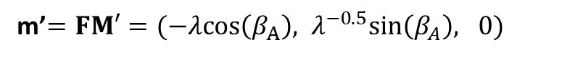
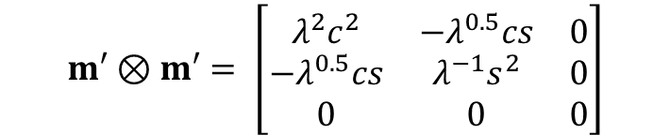

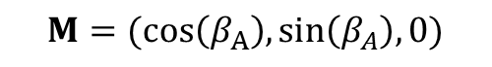
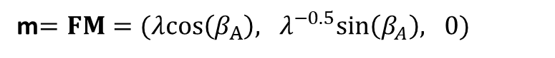
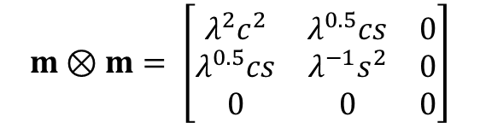
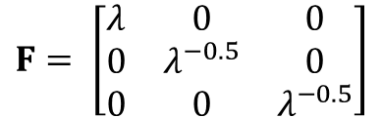
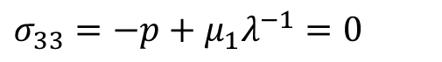
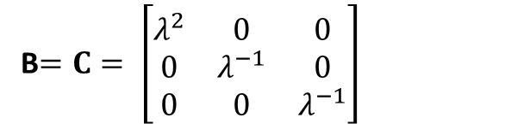
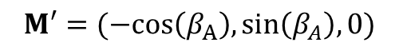
Virtual Experiment: Uniaxial Test
$$M=(cos\left(β_{A}\right), sin\left(β_{A}\right), 0)$$
B$=C= \left[\begin{matrix}λ^{2} & 0 & 0 \\ 0 & λ^{−1} & 0 \\ 0 & 0 & λ^{−1}\end{matrix}\right]$
$$M′=(−cos\left(β_{A}\right), sin\left(β_{A}\right), 0)$$
$$F= \left[\begin{matrix}λ & 0 & 0 \\ 0 & λ^{−0.5} & 0 \\ 0 & 0 & λ^{−0.5}\end{matrix}\right]$$
m$=FM=(λcos\left(β_{A}\right), λ^{−0.5}sin\left(β_{A}\right), 0)$
m’$=FM′=(−λcos\left(β_{A}\right), λ^{−0.5}sin\left(β_{A}\right), 0)$
$$I_{1}=trace\left(C\right)=λ^{2}+2λ^{−1}$$
$I_{4}=m⋅m=$ $λ^{2}\cos^{2}\left(β_{A}\right)+λ^{−1}\sin^{2}\left(β_{A}\right)$
$I_{6}=m⋅m=$ $λ^{2}\cos^{2}\left(β_{A}\right)+λ^{−1}\sin^{2}\left(β_{A}\right)$
$$m⊗m= \left[\begin{matrix}λ^{2}c^{2} & λ^{0.5}cs & 0 \\ λ^{0.5}cs & λ^{−1}s^{2} & 0 \\ 0 & 0 & 0\end{matrix}\right]$$
$$m′⊗m′= \left[\begin{matrix}λ^{2}c^{2} & −λ^{0.5}cs & 0 \\ {−λ}^{0.5}cs & λ^{−1}s^{2} & 0 \\ 0 & 0 & 0\end{matrix}\right]$$
$σ_{11}=−p+μ_{1}λ^{2}+2μ_{2}(I_{4}−1)e^{μ_{3}(I_{4}−1)^{2}}$ $λ^{2}c^{2}$+ $2μ_{2}\left(I_{6}−1\right)e^{μ_{3}(I_{6}−1)^{2}}λ^{2}c^{2}$
$σ_{22}=−p+μ_{1}λ^{−1}+2μ_{2}(I_{4}−1)e^{μ_{3}(I_{4}−1)^{2}}$ $λ^{−1}s^{2}$+ $2μ_{2}\left(I_{6}−1\right)e^{μ_{3}(I_{6}−1)^{2}}λ^{−1}s^{2}$
$$σ_{33}=−p+μ_{1}λ^{−1}=0$$
$$p=μ_{1}λ^{−1}$$
$$σ_{12}=σ_{21}=σ_{13}=σ_{31}=σ_{23}=σ_{32}=0$$

Slide 11
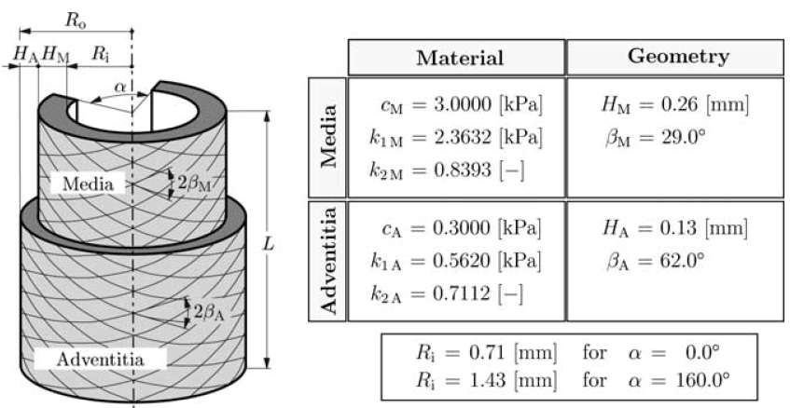
Virtual Experiment: Uniaxial Test

Slide 12
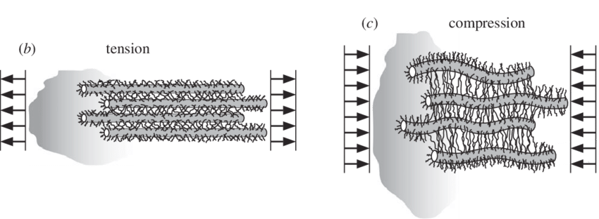
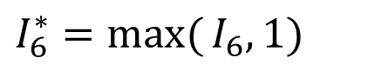
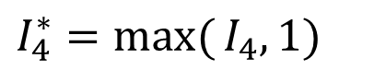

Excluding Compressed Collagen Fibres
For collagen rich fibrous biological tissue, it is often reasonable to assume that the collagen fibres will not support compression, but only bear stretching.
Introduce
$$I_{4}^{∗}=\max{(}I_{4},1)$$
$$I_{6}^{∗}=\max{(}I_{6},1)$$
Then we have
$$σ=−pI+μ_{1}B+2μ_{2}(I_{4}^{∗}−1)e^{μ_{3}(I_{4}^{∗}−1)^{2}}m⊗m \\ +2μ_{2}(I_{6}^{∗}−1)e^{μ_{3}(I_{6}^{∗}−1)^{2}}m′⊗m′$$

Slide 13


The Effects of Residual Stress on Elastic Response
Unloaded arterial ring showing compression of the inner layer (intima)

Slide 14


3D Residual Stresses

Slide 15








Residual Stress
$$B_{r} (\text{reference} \text{configuration})$$
$$B_{t} (\text{current} \text{configuration})$$
May not exist always
sits in $B_{r}$
not associated with a deformation
not given by a constitutive law
no distinction between $σ^{(r)}$and $S^{(r)}$
$$Jσ^{(r)}=FS^{(r)} F|_{B_{r}}=I$$

Slide 16
Strain Energy Function with $σ^{(r)}$
Without preferred direction for reinforcement
$$Ψ=\hat{Ψ}(C,σ^{(r)}, \text{combinations} \text{of} σ^{(r)} \text{and} C)$$
With preferred direction for reinforcement M
$$Ψ=\hat{Ψ}(C,σ^{(r)},M⊗M, \text{combinations})$$
Wang, H. M., et al. BMMB, 2014: 99–113

Slide 17


Applications to Arteries
Circumferential residual stress distribution
Alastrué Victor, et al. "Assessing the use of the “opening angle method” to enforce residual stresses in patient-specific arteries." Annals of biomedical engineering 35 (2007): 1821-1837.

Slide 18
Fitting to Experimental Data

Slide 19



Transversely Isotropic Incompressible Material
$$\text{Neo} \text{hookean}\text{ − }\text{isotropic} {\text{c}}_{0}$$
$$Ψ=c_{0}(I_{1}−3)+p(J−1)$$
$$\text{May} \text{Newman}\text{ − }\text{anisotropic}\text{, }\text{coupled} c_{0},c_{1},c_{2}$$
$$Ψ=c_{0}[\exp{(}c_{1}[I_{1}−3]^{2}+c_{2}[I_{4}−1]^{2})−1]+p(J−1)$$
$$\text{Holzapfel}\text{ − }\text{anisotropic}\text{, }\text{decoupled} c_{0},c_{1},c_{2}$$
$$Ψ=c_{0}[I_{1}−3]+\frac{c_{1}}{2c_{2}}[\exp{(}c_{2}[I_{4}−1]^{2})−1]+p(J−1)$$

Slide 20
Fitting to Experimental Data
A competent strain energy function
can fit to a particular tissue test
can predict material behaviours under different loading conditions, in particular different from experimental tests
The basic concepts of Optimization
Minimization
“Objective Function”
(unknown constants)
Subject to: Constraints
Guan D, et al. 2019,doi:10.1007/s10237-019-01140-6

Slide 21

Optimization Problem for Strain Energy Model Fitting
Minimization
(c1, c2, c3, etc)
Subject to: c_{i} >g
c_{i} material constants
g constraints
k data points
This problem is actually a nonlinear least-squares curve fitting problem, which can be solved with the Matlab function lsqnonlin.

Slide 22
The Calibration Procedure
Biomechanical Testing:
Deformation State
Stress State
Experimental Stress
Optimization:
Minimize error between experimental and Constitutive Model stresses; Constitutive Constants are updated
Microstructures (fibres, etc)
Experimental Deformation:
Stretch, F, C, E, f, etc
Constitutive Model:
Postulate Model
Derive Stress State
Need Experimental Deformation as input
Stress Predicted from Material Model

Slide 23

All models are wrong, but some are useful
Book: Empirical Model-Building and Response Surfaces, 1987
.. all models are approximations. Essentially, all models are wrong, but some are useful. However, the approximate nature of the model must always be borne in mind....
“shall not select the best-fitting model but shall select the best-predicting model.”
George Box
One of the great statistical minds of the 20th century

Slide 24


Model A vs Model B

Slide 25


Model Complexity
Complexity: A model’s inherent flexibility that enables it to fit a wide range of data pattern

Slide 26


Relationship between Goodness of Fit and Generalizability

Slide 27

Akaike Information Criterion (AIC)
Given a collection of models for the data, AIC estimates the quality of each model, relative to each of the other models.
Trade-off between the goodness of fit and the simplicity of the model
A balance between the risk of overfitting and the risk of underfitting
The model that minimizes AIC should be preferred
https://en.wikipedia.org/wiki/Akaike_information_criterion
Notes:
the maximized value of the likelihood function for the model
With least squares fitting, the maximum likelihood estimate for the variance of a model's residuals distributions is
\sigma^2 = RSS/n, and RSS = \sum (y_i – m_i)^2, then
ln(f) = -n/2 ln(\sigma^2)
AIC = 2k + n ln(\sigma^2) – 2C (C is a constant, can be ignored)
Note that if all the models have the same k, then selecting the model with minimum AIC is equivalent to selecting the model with minimum RSS—which is the usual objective of model selection based on least squares.

Slide 28











Example: Mitral Valve Leaflets
Characterize material properties and collagens in heathy porcine MV
Possible strain energy functions
(2 paras)
$$Ψ_{1}\left(I_{1}\right)=c_{1}(I_{1}−3)$$
$$Ψ_{2}\left(I_{1},I_{4}\right)=c_{1}\left(I_{1}−3\right)+\frac{k_{1}}{{2k}_{2}}\left(e^{k_{2}{\left(I_{4}−1\right)}^{2}}−1\right)$$
(3 paras)
$$Ψ_{3}\left(I_{1},I_{4}\right)=\frac{c_{1}}{c_{2}} (e^{{(I}_{1}−3)}−1) +\frac{k_{1}}{{2k}_{2}}\left(e^{k_{2}{\left(I_{4}−1\right)}^{2}}−1\right)$$
(4 paras)
$$Ψ_{4}\left(I_{1},I_{4}\right)=c_{1}( e^{{{c_{2}(I}_{1}−3)}^{2} +c_{3}{\left(\sqrt{I_{4}}−1\right)}^{4}} −1 )$$
(3 paras)
$$Ψ_{5}\left(I_{1},I_{4}\right)=c_{1}( e^{{{{[c}_{2}(I}_{1}−3)}^{2} +c_{3}{\left(I_{4}−1\right)}^{2}]} −1 )$$
(3 paras)
$$Ψ_{1}$$
AIC
$$Ψ_{4}$$
$$Ψ_{5}$$
$$Ψ_{2}$$
$$Ψ_{3}$$
Chen, Shengda, et al. journal of the mechanical behavior of biomedical materials 111 (2020): 104011.

Slide 29
Summary
Strain energy functions for two families of fibres
Excluding compressed fibres from a fibre reinforced material
Residual stress to achieve a more homogeneous stress distribution in various biological tissue, i.e. arterial wall
Parameter estimation from biomechanical tests using least-square fitting
Model selection using AIC to identify a proper strain energy function, avoiding over-fitting or under-fitting

Slide 30




Further Considerations
Fibre dispersion
Fibre recruitment
Crosslink
Muscle fibres

Slide 31



How to formulate $σ^{(r)}$
$$(1) \text{Isotropy}\text{: }Q \text{can} \text{be} \text{any} \text{orthogonal} \text{tensor}$$
$$\text{thus} σ^{(r)}=σ^{(r)}I$$
$$\text{Apply} \text{Div}​(σ^{(r)}I)=0 ⇒ \text{Grad}σ^{(r)}=0 ⇒ σ^{(r)}=0 \text{if} \text{traction} \text{free}$$
(Residual stress cannot be supported by an isotropic body)
$$(2) \text{trasnversely} \text{isotropy} (k_{1}\text{: }\text{direction} \text{of} \text{reinforcement})$$
$$σ^{(r)}={σ_{1}}^{(r)}(I−k_{1}⊗k_{1})+{σ_{3}}^{(r)}k_{1}⊗k_{1} ({σ_{1}}^{(r)}={σ_{2}}^{(r)})$$
$$(3) \text{orthotropy}\text{: }\text{three} \text{mutually} \text{orthogonal} \text{directions} (k_{1},k_{2},k_{3})$$
$$σ^{(r)}={σ_{1}}^{(r)}k_{1}⊗k_{1}+{σ_{2}}^{(r)}k_{2}⊗k_{2}+{σ_{3}}^{(r)}k_{3}⊗k_{3}$$

